Slide 1

bad USBs are scary!!
(build one with a Raspberry Pi Pico for ₹ 349)
N
by Nil K

Slide 2

the demo

Slide 3
the next 30 minutes
1
2
3
4
5
the demo
working
DIY
protect
blue team
reverse shell,
HID devices,
Adafruit Circuit Python,
how to defend
HID info detection,
prank video
keystroke injections,
mass storage quarantine
Wi-Fi Duck
HID lib folder,
automation
news articles

Slide 4
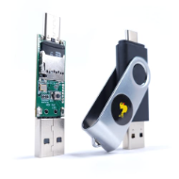
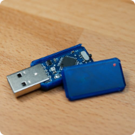
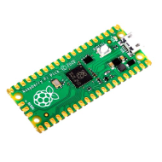
what do you need?
USB Rubber Ducky (Hak5) (₹6,919.58)
USB Nova (Spacehuhn) (₹4,149.84)
Raspberry Pi Pico (₹349)
micro controller board by Raspberry Pi:
the original Rubber Ducky everyone knows about:
like USB Rubber Ducky, plus:
RP2040 chip
Drag and drop scripts
97% cheaper
Ducky Script
Easy attack/setup mode switching
drag-drop programming using mass storage over USB
USB A/C connectivity
Supports multiple keyboard layouts

Slide 5
how does it work?
1
it's recognised as an HID device(0×03), which is trusted by default
2
it can type up to 1000 wpm, faster than any human

Slide 6

building it yourself
1
gh clone dbisu/pico-ducky
2
move files around
or, write at a script to automate this part & save time,
navigate to github.com/dbisu/pico-ducky and follow README.md,
3
don't waste time
utilise this newly saved time by reading a book - The Ministry for the Future​.

Slide 7

creating attacks
https://github.com/hak5/usbrubberducky-payloads/tree/master is the official repository for verified payloads, BUT
you can find scripts from random people on the internet as well, obviously do NOT run as it is.
ask LLM models like ChatGPT to understand or write Ducky Scripts

Slide 8

Mr Robot (2015)
If you're a fan of the TV show Mr Robot, you might remember when Rubber Ducky was featured on the show.

Slide 9
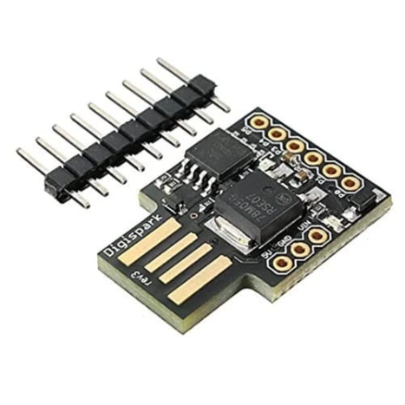
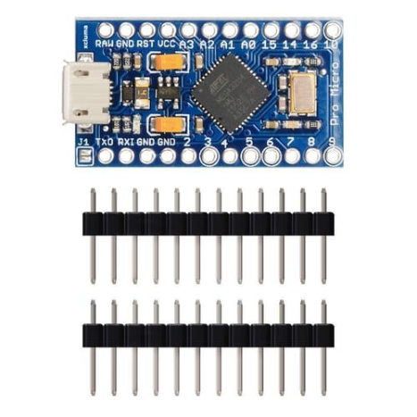
alternative micro-controllers
Attiny85
Atmega 32u4
stealing Wi-Fi passwords in seconds - link
brute-forcing the android/iPhone PIN - link

Slide 10
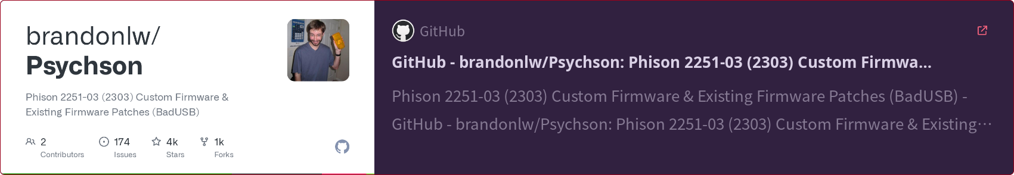
reprogramming a USB flash drive

Slide 11
how do you protect yourself?
don't plugin unknown hardware
Win + L always!
NEVER plug in an unknown device. ALWAYS use an isolated environment.
NEVER step away from your computer without locking it first.

Slide 12

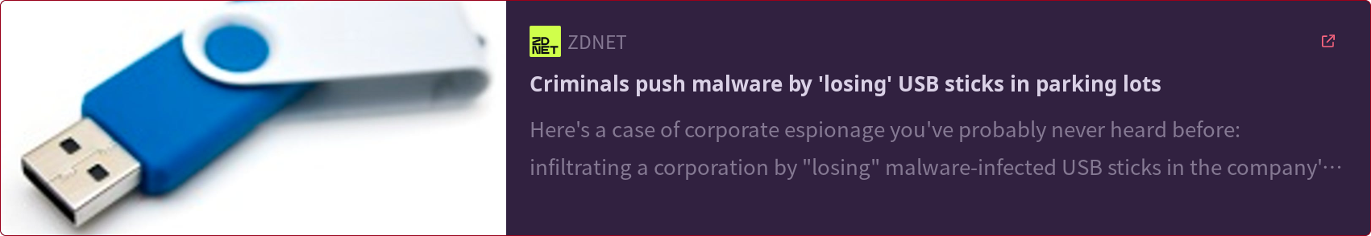

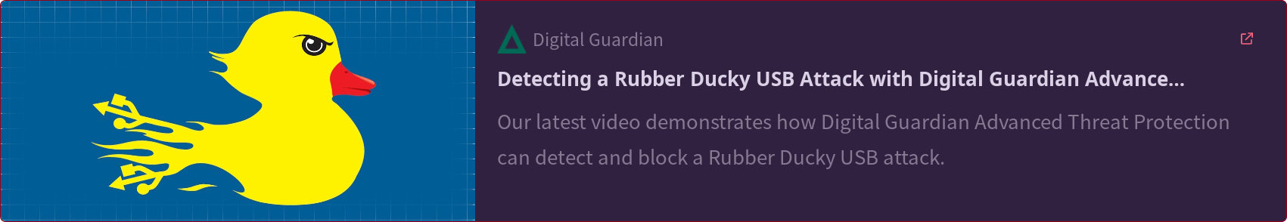
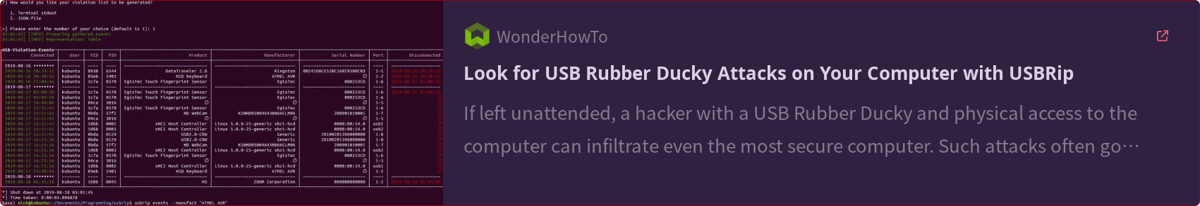

Slide 13
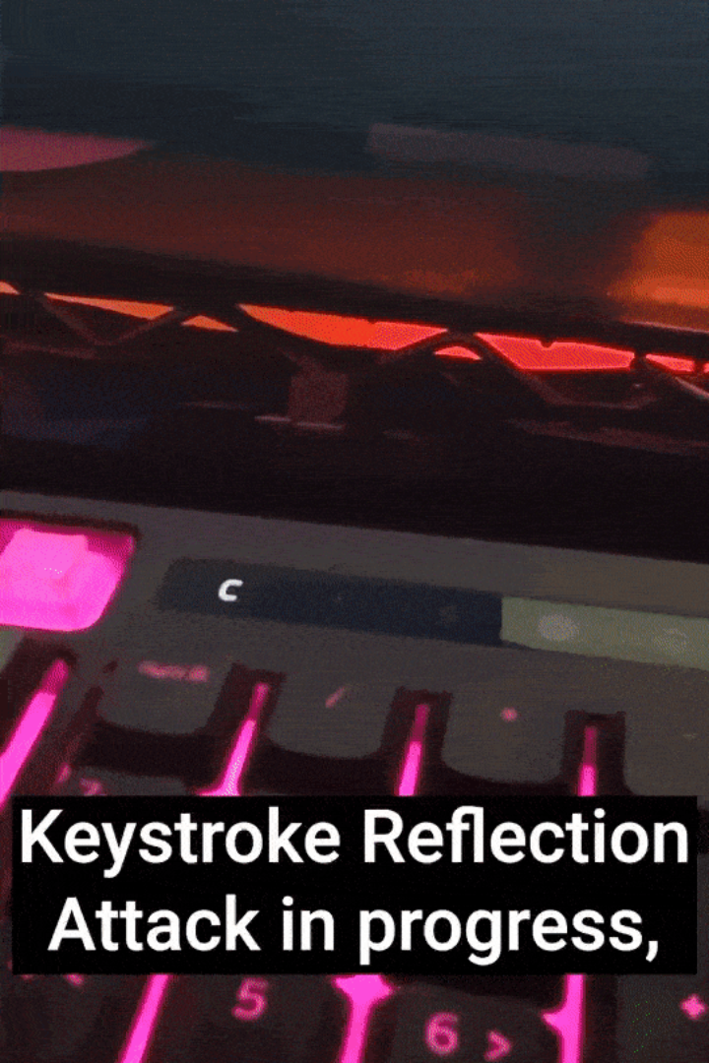
new ducky​ 2022
DuckyScript 3.0
extension functions(like libraries) to build with, and create more creative attacks,
keystroke reflection
data is gathered using keystroke injection, encoded into CAPS LOCK/NUM LOCK combos, which is read by Ducky
hardware id cloning
mimic any USB device's vendor & product id, as well as manufacturer, serial number and product strings

Slide 14
Listen Up, Blue Team!
1
trust but verify
before you plug in your device, make sure it's malware-free! use a disk image tool to make a copy of your hard drive, and check it against the original. don't risk infecting your computer with malicious code.
2
use firewall
use a firewall to control what programs access your network and the internet. create rules to block malware and keep company systems safe.
3
enable password authentication for administrative access
setup group policies by enabling password authentication for administrative access. it's a simple way to protect your sensitive data from unauthorised access.

Slide 15

what did we learn?
bad USB attacks have crazy potential, but you can protect yourself.
building a rubber ducky alternative is cost-effective, highly educational, and extremely customizable.
cucumbers in fruit salad are heaven on earth

Slide 16


/nileshevrywhr

Slide 17

the answer to your questions?
“ask and it will be given to you" (Matthew 7:7)

